Slide 1
THE SOCIABILITY OF RISK: SEX WORK, CRIMINALIZATION, AND HIV/AIDS IN KAMPALA, UGANDA
Serena Cruz
Amsterdam Research Center for Gender & Sexuality (ARC-GS)
University of Amsterdam
serena_cruz@yahoo.com

Slide 2
RESULTS
Central research question: How do women manage daily risks associated with sex work, criminalization, and HIV/AIDS in the Slums of Kampala, Uganda?
The study reveals that women’s social networks have the greatest impact on their ability to manage daily risks.
However, three important variables intervene with women’s risk management:
(1) The sex work environment
(2) The divergence in women’s social relationships
(3) The current policy approach guiding HIV healthcare

Slide 3
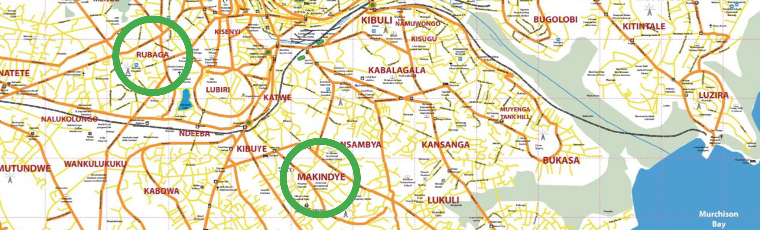
BACKGROUND
In Kampala women engaging in “high risk” sexual practices, such as commercial sex work, have an estimated 33-37% HIV seroprevalence (Vandepitte et al. 2011; Hladik et al. 2017).
In response to this statistic I set out to investigate how women manage daily risks associated with sex work, criminalization, and HIV/AIDS.
METHODOLOGY
Primary ethnographic data collection occurred over 15 months within two Kampala Divisions (Rubaga and Makindye).
Involved participant observation, group discussions, and informal, unstructured interviews with female commercial sex workers.
Research insights then informed policy analysis.

Slide 4
EXPLAINING THE RESULTS
A woman’s physical sex work environment impacts her ability to safeguard private property (e.g., condoms, cash, medications, clothing, shoes, etc.).
A woman with fewer personal belongings is perceived by other women in the brothel as less capable of minimizing risks.
Women deemed more capable of maintaining their social ties are far more likely to improve their commercial sex work prospects.
Current HIV interventions, undermine women’s social resources.
Women struggle to adhere to recommended HIV/AIDS treatment protocols due to conflicting (social) demands.

Slide 5
CONLUSIONS
This research underscores the sociability of women’s HIV risk and risk management, and the implications of these social processes on current HIV/AIDS prevention and treatment protocols.
DISCLOSURE
There are no conflicts of interest.
Funding for this research came from Shepard Broad Foundation, INC. and Florida International University.

